Slide 1
Microelectronic Control Systems
Summary: Input / Output pins, Timer/Counter, PWM, Code examples …
(first iteration, some errors could be expected!)

Slide 2
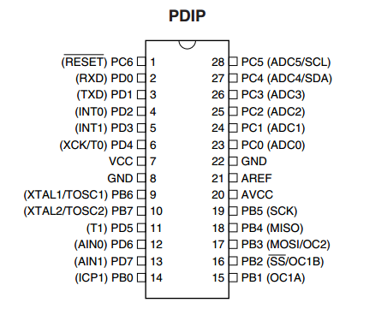
Summary: Input pins (1)
We use Data Direction Registers to choose whether particular pin works as input (0 in DDR) or output (1 in DDR).
Furthermore, if we expect ACTIVE_LOW input, we would set pullup on the pin.
To ensure a pin is in input mode:
DDRX &= ~(1<< pin); //set pin as input
Where X is D, B or C for pins PD, PB and PC;
pin is PD0-PD7, PB0-PB5 or PC0-PC6.
* on AVR board pins are further limited, see numbers under the pins to ensure right pin name.
PORTX |= 1 << pin ; // enable pullup on pin
Remark: Some more complex devices require used pins to be set to input, for example ADC and SPI communication. Do not use pullup for them.

Slide 3
Summary: Input pins (2)
After the setup for Input is done, the input values will appear in PINX.
Use bitmasks to read particular bits.
To check if a pin is high or low:
if(PINX & (1<<pin))
{ //TODO }
To check if an ACTIVE LOW pin is active:
if(~PINX & (1<<pin))
{ //TODO }

Slide 4
Summary: Output pins
To output a digital value, PWM signal or use pins in modes like SPI, set corresponding DDR bits to 1:
DDRX |= (1<< pin); //set pin as output
Then use PORTX to choose if output should be high or low:
PORTX |= (1<< pin); //set pin to high
PORTX &= ~(1<< pin); // set pin to low

Slide 5
DDR / PORT setup and usage example
Assume we want to have 4 outputs for LEDs and 2 inputs for buttons (ACTIVE_LOW):
void init(void)
{
DDRB |= 1<< PB0| 1<< PB1| 1<< PB2| 1<< PB3; //outputs
DDRD &= ~(1<< PD2| 1<< PD3); //inputs
PORTD |= 1<< PD2 | 1<<PD3; //pullup on PD2 and PD3
}
main(){
while(1)
{
if(~PIND & (1<< PD2| 1<< PD3)) PORTB = 255; //all LEDs ON
else PORTB = 0; //all LEDs ON
}}

Slide 6
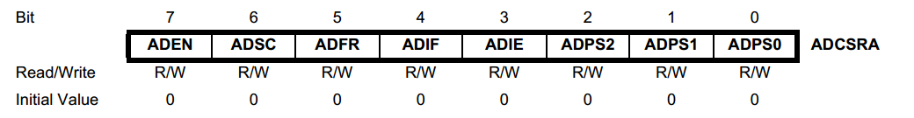
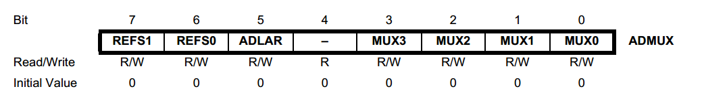
Summary: ADC
The function of ADC: to represent analog inputs in digital form.
In practice, you are likely to use it for:
Reading potentiometer value
Reading analog sensor
Measuring some voltage in circuit
How to use it in our code?
ADC operation is controlled by two registers (mostly)

Slide 7
ADC modes of operation
ADC will provide the digital representation of analog value in 8-bit registers ADCH and ADCL, which could be referenced from our code by uint16_t ADCW:
myReading = ADCW; //16 bit value (ADC is only 10 bit long)
There are 2 modes of operation: normal and free running.
Normal mode means that after writing 1 to ADSC, exactly 1 conversion will be made and ADSC will be automatically reset (back to 0) by hardware (waiting for user to place 1 there again, at the time needed for conversion).
Free running mode will do conversion with some frequency determined by ADC prescaler, and keep doing it as long as ADSC == 1 (remains unchanged all the time)

Slide 8
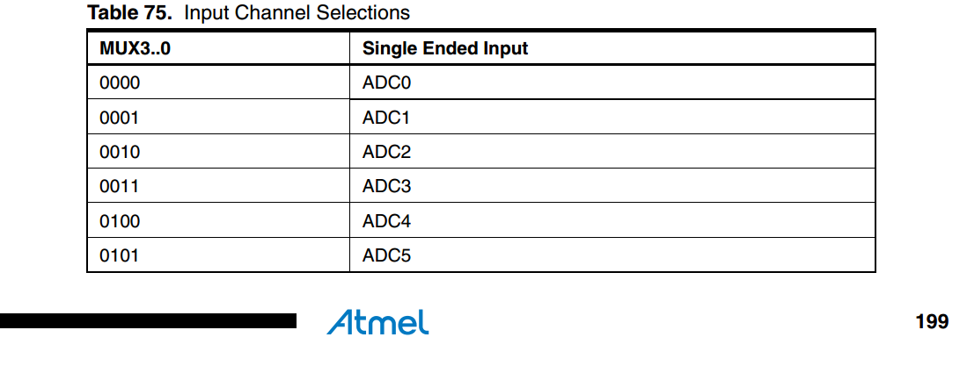
ADC input channel
ADC can receive the analog value for conversion from 6 pins: PC0-5. However, at a single moment we must connect it only to one of the pins, and this is done using ADMUX register. There are 4 MUX bits: MUX3, MUX2, MUX1, MUX0. You can change the ADC channel during runtime.
The setting for MUX bits is just number of pin written in binary form, as you can verify with the table below.

Slide 9
ADC Example incl. ADC interrupt
There is an option to call an interrupt every time conversion is completed. Setting for this would be:
ADCSRA |= 1<<ADEN; // Enable ADC
ADCSRA |= 1<<ADIE; //Enable interrupt
ADMUX |= pin;// Choose your input pin
DDRC &= ~( 1<< pin); //Make sure input pin // also works as input!
volatile uint16_t myVariable;
ISR(ADC_vect)
{
myVariable = ADCW;
//TODO: use the reading!
}

Slide 10
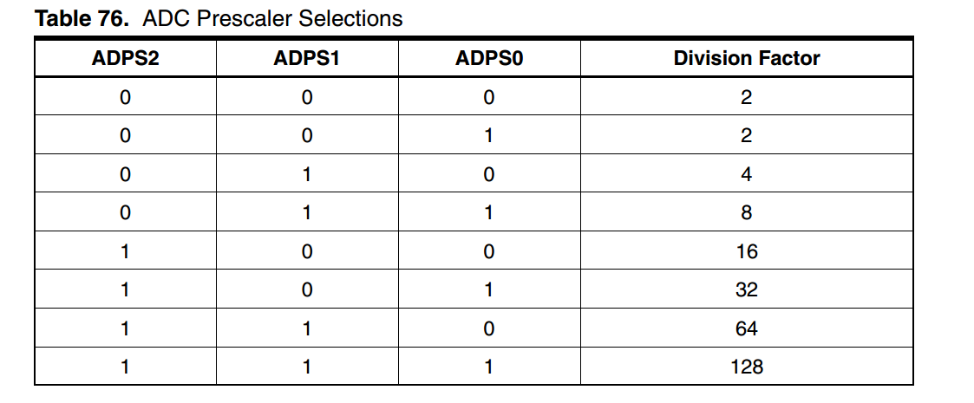
ADC – further settings (1)
As already mentioned, ADC has few more settings:
Prescaler frequency (different from timer prescalers!):
For example, use the highest prescaler to maximise conversion precision:
ADCSRA |= 1<<ADPS2 | 1<<ADPS1 | 1<<ADPS0;

Slide 11
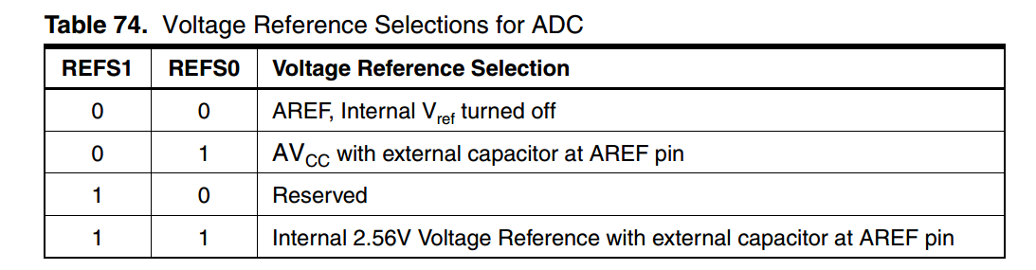
ADC – further settings (2)
Free running mode:
ADCSRA |= 1 << ADFR;
Choose reference voltage:
ADSCRA |= 1 << REFS0; //AVcc as reference

Slide 12
ADC – full setup example
Assume we want to convert a value of potentiometer connected to PC3 continuously, and use it to control output of some device (e.g. DC motor or LED):
void init(void)
{
ADCSRA |= 1<< ADEN | 1<< ADFR | 1<< ADSC;//ADC enabled, free run
ADMUX |= 1<< MUX0 | 1<< MUX1;//Selected ADC channel: 3
DDRC &= ~(1<< PC3);//Required: ADC3 configured as an input
}
main(){
while(1)
{
output = ADCW; // output can be OCR register for PWM. If it is
// a simple variable, you must actually use it // with more comments / statements.
}}

Slide 13
Summary: Timer/Counters (1)
As you might have already learned, AtMega8 has 3 Timer/Counters.
They are:
Timer/Counter0 – 8 bit (TCNT0 overflows after 255)
Timer/Counter1 – 16 bit (TCNT1 overflows after 65535)
Timer/Counter2 – 8 bit (TCNT2 overflows after 255)
How Timer/Counter work:
if prescaler is chosen to be value P ( e.g. P = 1, 8, 64, 1024),
then corresponding TCNT register will be incremented (increased by 1) every time clock generates P signals (in our case, clock normally generates 8M signals per second).
If prescaler is not set, TCNT is never changed in hardware (timer is turned off).

Slide 14
Summary: Timer/Counters (2)
Therefore, to calculate the frequency of overflows:
foverflows = fclock / ( P * 2^( bits_in_timer_counter ) ) where P is prescaler value, bits_in_timer_coutner is 8 for TC0 and TC2, or 16 for TC1.
If you measure some time in T = TCNT[Timer/Counter units] ( assume you measured time to be N [TC units], like 123 or some other number) and want to know how much it is in seconds [s]:
T [s] = T [TC units] * P / fclock = TCNT* P / fclock [s]
From this follows, that maximum time Tmax you can directly measure in TC is:
(for maximal prescaler of 1024)
Since N is 255 at most for TC0 and TC2 → Tmax = 255*1024 / 8M = 32,64 ms
Since N is 65535 at most for TC1 → Tmax = 65535 *1024/8M = 8,355 s

Slide 15
Summary: Timer/Counters (3)
How to measure any time using Timer/Counter (time greater than Tmax) ?
Simply count the number of overflows!
uint16_t overflows_TC1 = 0;
ISR(TIMER1_OVF_vect)
{
overflows_TC1++;
}
Then actual time would be:
t = overflows_TC1 * T1 + T[s],
where T1 is period of overflows of TC1 (inverse of frequency, see last slide for values / formula) and T[s] is equal TCNT* P / fclock [s]

Slide 16
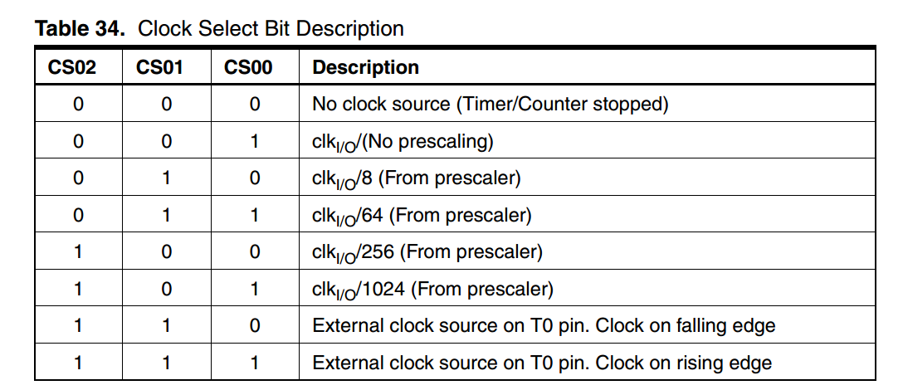
Summary: Prescaler init TC0 (1)
For TC0:
TCCR0 |= (1 << bit_name); //bit_name could be:
//CS02, CS01, CS00.
If you want a bit to be 0, just leave it not initialized (0 is default value).

Slide 17
Summary: Prescaler init TC0 (2)
Complete statements would be (choose only ONE line of the statements!) :
TCCR0 |= (1 << CS00) ; // P = 1
TCCR0 |= (1 << CS01) ; // P = 8
TCCR0 |= (1 << CS01) | (1 << CS00) ; // P = 64
TCCR0 |= (1 << CS02) ; // P = 256
TCCR0 |= (1 << CS02) | (1 << CS00) ; // P = 1024

Slide 18
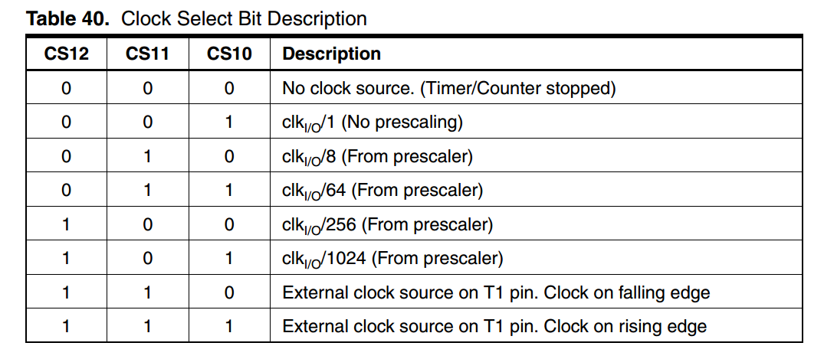
Summary: Prescaler init TC1
Complete statements for TC1 (choose only ONE line of the statements!) :
TCCR1B |= (1 << CS10) ; // P = 1
TCCR1B |= (1 << CS11) ; // P = 8
TCCR1B |= (1 << CS11) | (1 << CS10) ; // P = 64
TCCR1B |= (1 << CS12) ; // P = 256
TCCR1B|= (1 << CS12) | (1 << CS10) ; // P = 1024

Slide 19
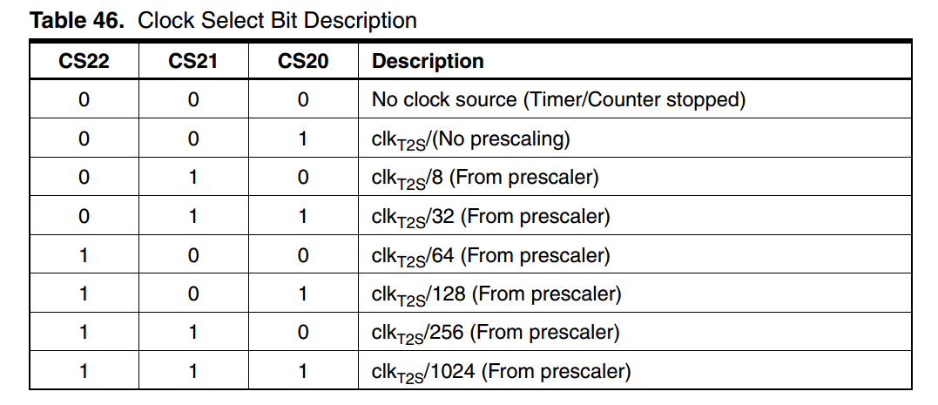
Summary: Prescaler init TC2
Complete statements for TC2 (choose only ONE line of the statements!) :
TCCR2 |= (1 << CS20) ; // P = 1
TCCR2 |= (1 << CS21) ; // P = 8
TCCR2 |= (1 << CS21) | (1 << CS20) ; // P = 32
TCCR2 |= (1 << CS22) ; // P = 64
TCCR2|= (1 << CS22) | (1 << CS20) ; // P = 128
TCCR2|= (1 << CS22) | (1 << CS21) ; // P = 256
TCCR2|= (1 << CS22) | (1 << CS21) | (1 << CS20) ; ; // P = 1024

Slide 20
Example: choosing prescaler for 1 Hz (1)
Assume your goal is to get some event repeated every second.
There will be actually few ways to have it done:
Check TCNT in the main loop, as soon as >= than 1 second expires, you execute your event and set TCNT to 0 manually;
if(TCNT >= oneSecond_in_TCNT_Units )
{myEvent();
TCNT=0;}
Compare interrupt: instead of checking in the main loop, you let the hardware do it for you. You clear TCNT manually;
CTC (Time Compare mode) on TC1 + overflow interrupt
//MODE 4 : CTC
TCCR1B |= 1<< WGM12;

Slide 21
Example: choosing prescaler for 1 Hz (2)
In all of the scenarios, you need to choose a prescaler which will let time to count upward of 1 s.
This means that frequency coming from formula must be less than 1 Hz:
foverflows < 1 Hz
fclock / ( P * 2^( bits_in_timer_counter ) ) < 1 Hz
fclock / (2^( bits_in_timer_counter ) ) < P
For 8 bit:
P > 31250
Can this condition be satisfied?
We could use overflows counter variable to count to 1 second with TC0 and TC2. Example will continue with TC1 where this trick is not needed.

Slide 22
Example: choosing prescaler for 1 Hz (3)
For 16 bit:
P > 122.07
Therefore following prescaler settings are appropriate:
TCCR1B |= (1 << CS12) ; // P = 256
TCCR1B|= (1 << CS12) | (1 << CS10) ; // P = 1024
What value should be check for to see 1 second has expired?
TCNT = t * fclock / P , where t is = 1 s ( or just 1)
31250 for P = 256
7813 for P = 1024 ( 7812.5 rounded up)

Slide 23
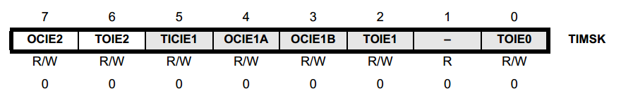
Summary: TC interrupts (1)
The simplest interrupt you can have for a TC is overflow interrupt. As long as TC is enabled ( prescaler is given a value, = not zero ), overflow interrupt will be called with frequency foverflows = fclock / ( P * 2^( bits_in_timer_counter ) )
It lets you do some tasks with a known period.
To enable this interrupt:
sei(); //global interrupts enabled
//choose only interrupts that you need
TIMSK |= 1<<TOIE0 ; // overflow interrupt enable for TC0
TIMSK |= 1<<TOIE1 ; // overflow interrupt enable for TC1
TIMSK |= 1<<TOIE2 ; // overflow interrupt enable for TC2

Slide 24
Summary: TC interrupts (2)
Do not forget to provide the Interrupt Service Routines outside of main function:
ISR(TIMER0_OVF_vect) //can be TIMER1, TIMER2 as well
{
//TODO
}
otherwise your program may crash!!!
Another very important interrupt for TCs is compare interrupt. You can choose a value for OCR1A, OCR1B for TC1 and OCR2 for TC2. (OCR stands for Output Compare Register, and there are 3 of them: 1A, 1B and 2)
Whenever TC will reach the value currently in Output Compare Register, the interrupt will be called.

Slide 25
Summary: TC interrupts (3)
To enable Output Compare Interrupts:
sei();
TIMSK |= ( 1 << OCIE1A ); //for OCR1A
TIMSK |= ( 1 << OCIE1B ); //for OCR1B
TIMSK |= ( 1 << OCIE2 ); //for OCR2
Remember, for this to work there must be a prescaler chosen for corresponding TC, as well as OCR value set correspondingly.
Use
ISR(TIMER1_COMPA_vect) //for OCR1A
ISR(TIMER1_COMPB_vect) //for OCR1B
ISR(TIMER2_COMP_vect) //for OCR2
service routines!

Slide 26
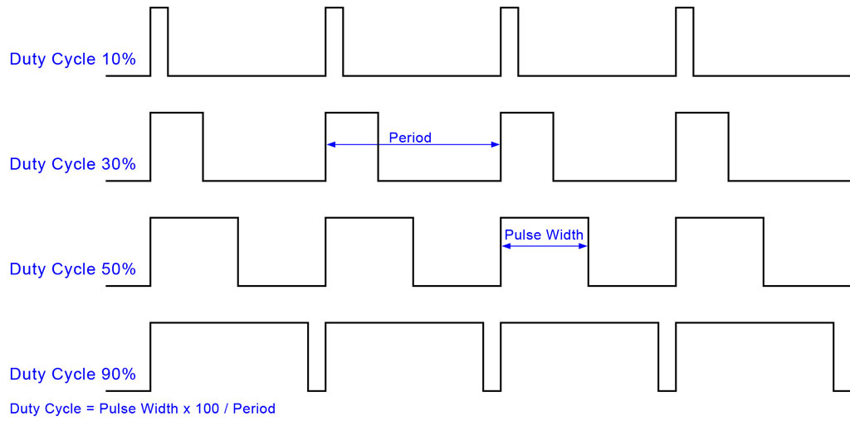
Hardware PWM using TCs (1)
Background / terms used:
PWM – pulse width modulation is a kind of signal which looks like in the graph:

Slide 27
Hardware PWM using TCs (2)
TC1 and TC2 can generate PWM in hardware. It is more precise and is independent of any other code running on your device, therefore it is recommended to always use Hardware PWM.
Important: Hardware PWM can be provided only on pins PB1, PB2, PB3.

Slide 28
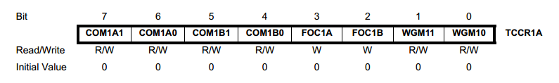
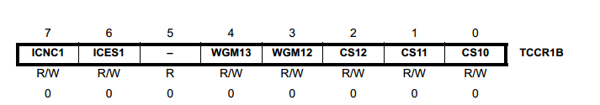
Hardware PWM using TC1 (1)
Setup of TC1 is slightly complicated by the fact that it‘s control register is split into two parts, A and B.
Use quoted tables to determine bits you need to set for your operation mode -> find in which register part those bits are -> use known syntax:
REGISTER |= ( 1<< bit_to_set ) ;

Slide 29
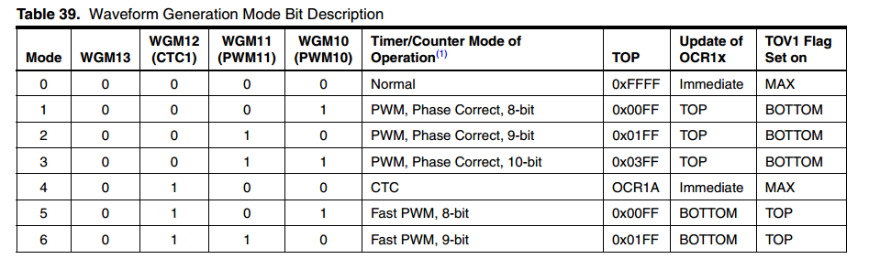
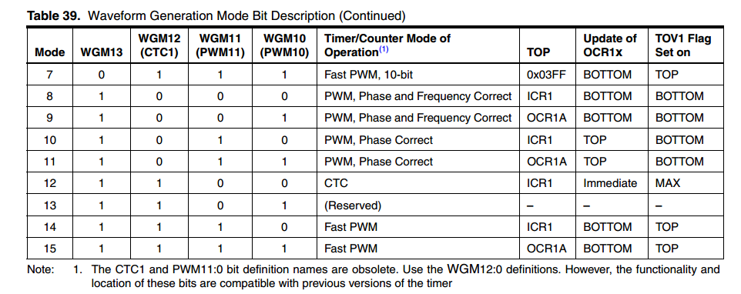
Hardware PWM using TC1 (2)

Slide 30
Hardware PWM using TC1 (3)
From all the PWM modes, let us pay attention to:
Modes 5,6,7 – 8, 9, 10 bit fast PWM
(convenient to control LEDs, heaters, fans, magnets, etc.)
Frequency of PWM in this mode will be: foverflows = fclock / ( P * 2^( PWM_bits) )
When choosing PWM mode consider: The more bits you have in your PWM, the more precise you can choose the output level (just like bits in ADC). On the other hand, your PWM frequency decreases as
f ~ 1 / (2^bits_in_PWM)
Low frequency means: slower response time; less smooth signal/reaction.
//MODE 5 : 8 bit fast PWM
TCCR1B |= 1<< WGM12;
TCCR1A |= 1<< WGM10;

Slide 31
Hardware PWM using TC1 (4)
//MODE 6 : 9 bit fast PWM
TCCR1B |= 1<< WGM12;
TCCR1A |= 1<< WGM11;
//MODE 7 : 10 bit fast PWM
TCCR1B |= 1<< WGM12;
TCCR1A |= 1<< WGM10 | 1<< WGM11;
Mode 14 – Fast PWM with top at ICR1
(used to control servos)
Frequency of PWM in this mode will be: foverflows = fclock / ( P * ICR1 )
//MODE 14 : fast PWM with top at ICR1
TCCR1B |= 1<< WGM13 | 1<< WGM12;
TCCR1A |= 1<< WGM10;

Slide 32
Hardware PWM using TC1: duty cycle
Duty cycle means what percentage of time the output is HIGH for your PWM signal.
I.e., it is the value of the analog signal you are approximating :
Vout = % duty cycle * Vcc
There are two options, duty cycle can be:
(TOP – OCR)/TOP
OCR/TOP.
TOP is 2^bits for modes 5-7 and ICR1 for mode 14. Make sure you do not choose OCR greater than TOP.
COM ( Compare Output Mode ) bits will determine if option 1 or 2 determines your duty cycle.

Slide 33
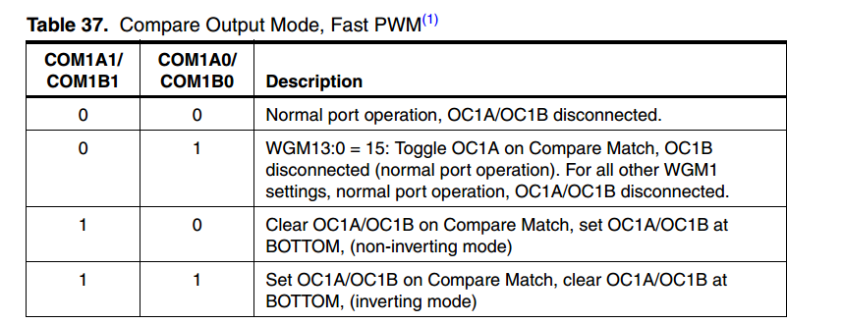
Hardware PWM using TC1: COM bits
Depending on which channel you want to use ( OCR1A on PB1 or OCR1B on PB2), you should set COM1A1 and COM1A0 or COM1B1 and COM1B0.
It is easiest to use option on 3rd row of this table.
Your duty cycle will be OCR/TOP.
TCCR1A |= 1<< COM1A1 ; // for OCR1A on PB1
TCCR1A |= 1 << COM1B1 ; // for OCR1B on PB2

Slide 34
Hardware PWM using TC1: conclusion
Therefore, to use Hardware PWM on TC1, you have to:
Choose mode of operation according to the device you work with and precision/speed requirement. Initialize TC1 for this mode.
Set COM bits for channels you want to use ( you can have 2 PWM signals in the same mode but different duty cycle coming from TC1)
Set OCR1A or OCR1B and enjoy your PWM on PB1 or PB2!

Slide 35
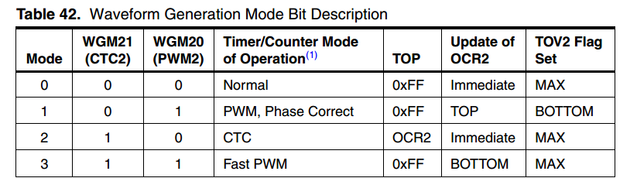
Hardware PWM using TC2
Timer/Counter 2 has less modes to choose from:
To use mode 3: Fast PWM (8 bit), set:
TCCR2 |= 1 << WGM21 | 1 << WGM20;

Slide 36
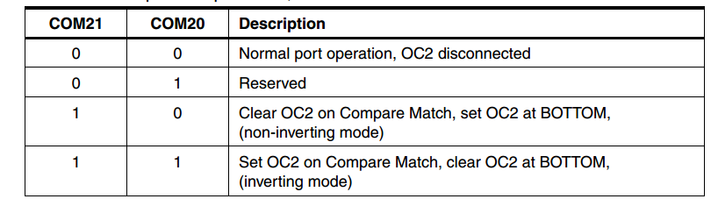
Hardware PWM using TC2: COM bits
Again we will use non-inverting mode.
Your duty cycle will be OCR2 / TOP.
TCCR2 |= 1<< COM21 ; // for PWM on PB3

Slide 37
Hardware PWM using TCs: conclusion
Therefore, to use Hardware PWM on TC2:
TCCR2 |= 1 << WGM21 | 1 << WGM20;
TCCR2 |= 1<< COM21 ;
OCR2 = 200 ; // 200 is an example. Use value from 0 to 255 to choose duty cycle.
Remarks:
you can use PWM AND Compare interrupts at the same time.
BUT: Manipulations to TCNTs can alter the functionality of both PWM and interrupts.

Slide 38
Controlling servos
A typical servo will rotate between NEGATIVE_LIMIT, 0 and POSITIVE_LIMIT according to pulse length in PWM signal it receives.
The servos you work with in the labs need:
1 ms pulse for NEGATIVE_LIMIT;
1,5 ms pulse for 0 ;
2 ms pulse for POSITIVE_LIMIT.
According to specification, we should keep pulse width at 20 ms, but in practice we can go as low as 7 ms, updating servo set point even more frequently.

Slide 39
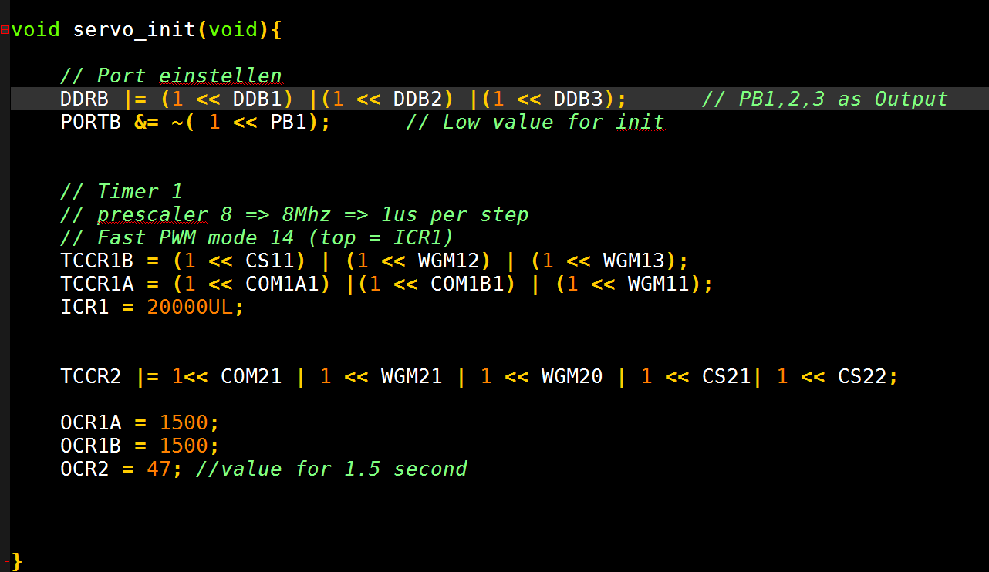
Controlling servos (1)
How many independent servos can a single ATMega8 control?
Actually all 3 with hardware PWM:
And more with software PWM! Limited by total pin number and PWM current consumption, which could be made low.

Slide 40
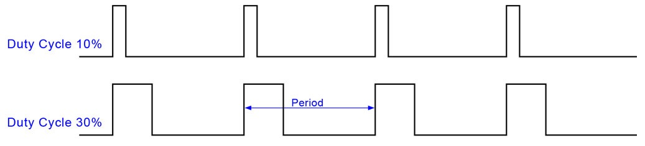
Hardware PWM using TCs: conclusion (1)
On connection between the programming and real electrical signal:
First, selection of PWM mode will determine the Period of PWM (together with prescaler setting). Imagine, you use
//MODE 7 : 10 bit fast PWM → T = 2^10 * P / fclock
TCCR1B |= 1<< WGM12;
TCCR1A |= 1<< WGM10 | 1<< WGM11;
And now you want to have duty cycle of 30%. What OCR value corresponds to this?
30%* 2^10 = 307. This is the value you should set in OCR1A or OCR1B.

Slide 41
8-bit PWM on PB1 and PB2, using TC1
void init(void)
{
DDRB |= 1<< PB1 | 1<< PB2;
TCCR1B |= (1 << CS10) ; // P = 1
//MODE 5 : 8 bit fast PWM, frequency = 64 kHz
TCCR1B |= 1<< WGM12;
TCCR1A |= 1<< WGM10;
TCCR1A |= 1<< COM1A1 ; // for OCR1A on PB1
TCCR1A |= 1 << COM1B1 ; // for OCR1B on PB2
}
main(){
while(1)
{
OCR1A=200; //PB1 duty cycle ~80%, change this to your value
OCR1B=100; //PB2 duty cycle ~40%
}}

Slide 42
Servo PWM on PB1 and PB2, using TC1
void init(void)
{
DDRB |= 1<< PB1 | 1<< PB2;
TCCR1B |= (1 << CS11) ; // P = 8
//MODE 14 : fast PWM with top at ICR1
TCCR1B |= 1<< WGM13 | 1<< WGM12;
TCCR1A |= 1<< WGM10;
TCCR1A |= 1<< COM1A1 ; // for OCR1A on PB1
TCCR1A |= 1 << COM1B1 ; // for OCR1B on PB2
ICR1=7000UL;
}
main(){
while(1)
{
OCR1A=1500; // PB1 sets servo close to 0 deg, 1.5 ms
OCR1B=1000; //PB2 sets servo close to minimal angle, 1.0 ms
}}

Slide 43
8-bit fast PWM on PB3, TC2
8-bit fast PWM on PB3, frequency = 64 kHz, TC2
void init(void)
{
DDRB |= 1<< PB3;
TCCR2 |= (1 << CS20) ; // P = 1
TCCR2 |= 1<< COM21 ;
TCCR2 |= 1 << WGM21 | 1 << WGM20;
TCCR2 |= 1<< COM21 ; // for PWM on PB3
}
main(){
while(1)
{
OCR2=150; // set to the needed value
}}

